Slide 1
CSE 331: MICROPROCESSOR INTERFACING & Embedded Systems
Lecture 1: Introduction to Microprocessor#1
Credit: Dr. Mohammad A Qayum
Notes:
1
Great class, combines concepts, skills, and experience.
Build real systems, bridge physical and virtual. Embedded systems critical to everyone, knowledge gained goes way beyond that.
Learn to how a system works and development flow, learn how a computer and embedded system works practically, learn how to program, learn how to use programming tools and mixed environments, learn about interfacing and design

Slide 2
OUTLINE
Course Description
Book, Labs, Equipment
Grading Criteria
Expectations/Responsibilities
Prerequisites
Microprocessor
History
Basics
Notes:
2
To do this week: get book, order a board, {read chapters 1 and 2 of the book or ebook 2 3 4}, do ws01, do HW1, install Keil uVision 4.73 on laptop

Slide 3
INSTRUCTOR
Instructor : Kazi Safkat
Class Time : RA 01:00 – 02:30 PM, Lab T 11:20 AM – 02:30 PM
Classroom : SAC204, Lab LIB609
Office: SAC 1196
Office Hours : Appointment Basis (Check office door for times)
Email : kazi.seen@northsouth.edu

Slide 4
TEXTBOOK AND REFERENCE
Textbook: Yifeng Zhu, Embedded Systems with ARM Cortex-M Microcontrollers in Assembly Language and C: Third Edition, E-Man Press, LLC, ISBN-13: 9780982692660, 2017
Reference books: Joseph Yiu, The definitive guide to ARM® Cortex®- M3 and Cortex®-M4 Processors, Third edition, ISBN-13: 9780124080829, 2014
Jonathan W. Valvano, Real-Time Interfacing to ARM® CortexTM-M Microcontrollers, Volume 2 Third edition, ISBN-13: 978-1463590154, 2013

Slide 5
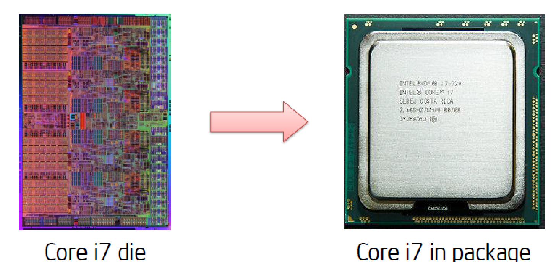
WHAT IS A MICROPROCESSOR?
Microprocessor is a Central Processing Unit (CPU) on a single chip.
It contains billions of transistors connected by wires.

Slide 6
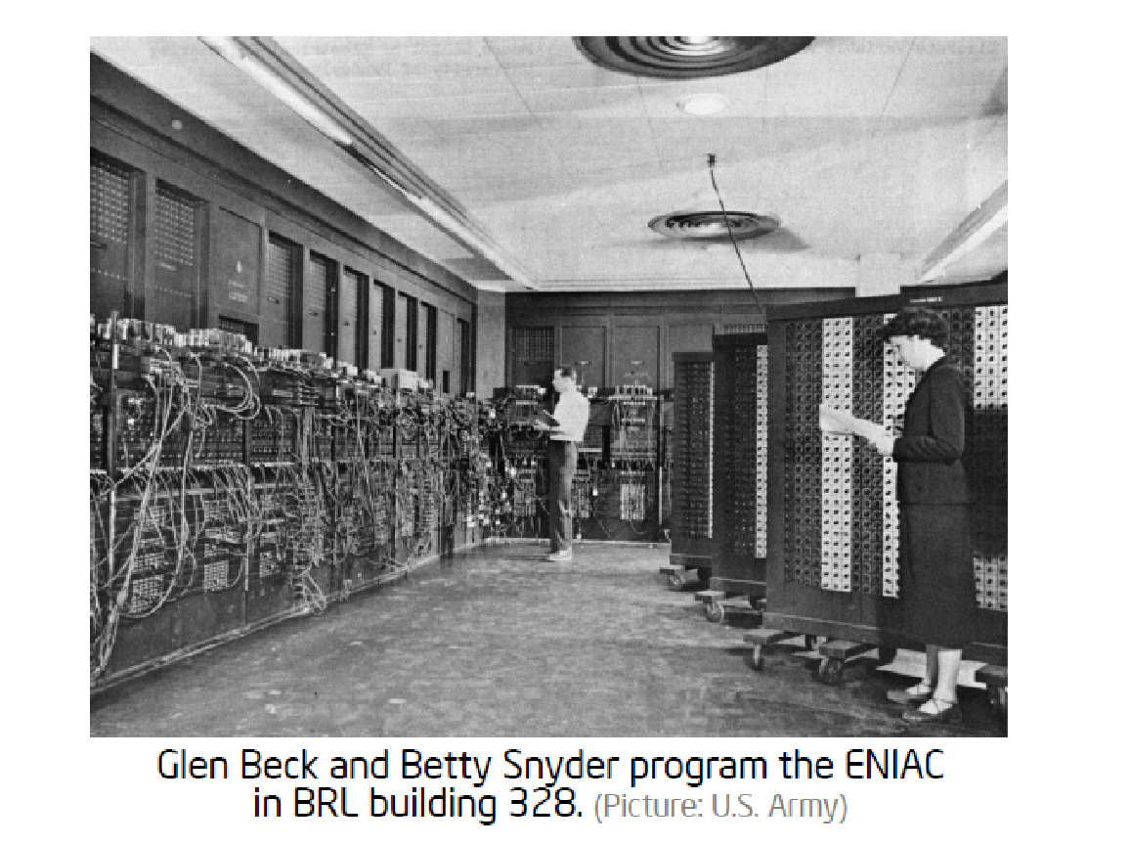
ELECTRICAL NUMERICAL INTEGRATOR AND CALCULATOR
Notes:
World’s first general purpose electronic computer

Slide 7
ENIAC
Designed for the U.S. Army's Ballistic Research Laboratory
Built out of
17,468 vacuum tubes
7,200 crystal diodes
1,500 relays
70,000 resistors
10,000 capacitors •
Consumed 150 kW of power •
Took up 72 sq m.
Weighted 27 tons •
Suffered a failure on average every 6 hours

Slide 8
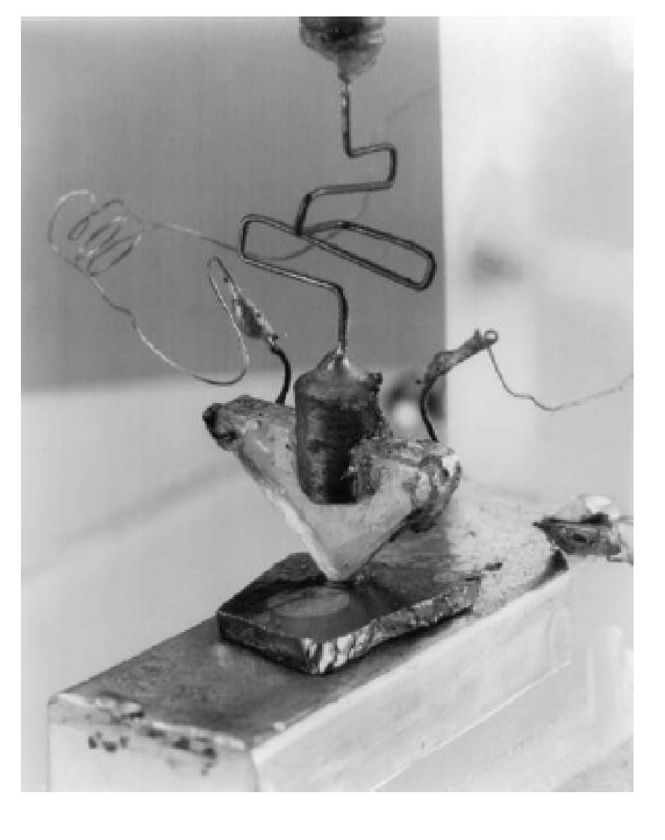
FIRST TRANSISTOR INVENTED IN 1947
Created by a team lead by
William Shockley at Bell Labs
Shockley later shared the
Noble prize in physics
Shockley semiconductors was
founded in Palo Alto in 1955
In 1957 Bob Noyce, Gordon Moore,
and 6 others (“Traitorous Eight”) leave
to found Fairchild semiconductor

Slide 9
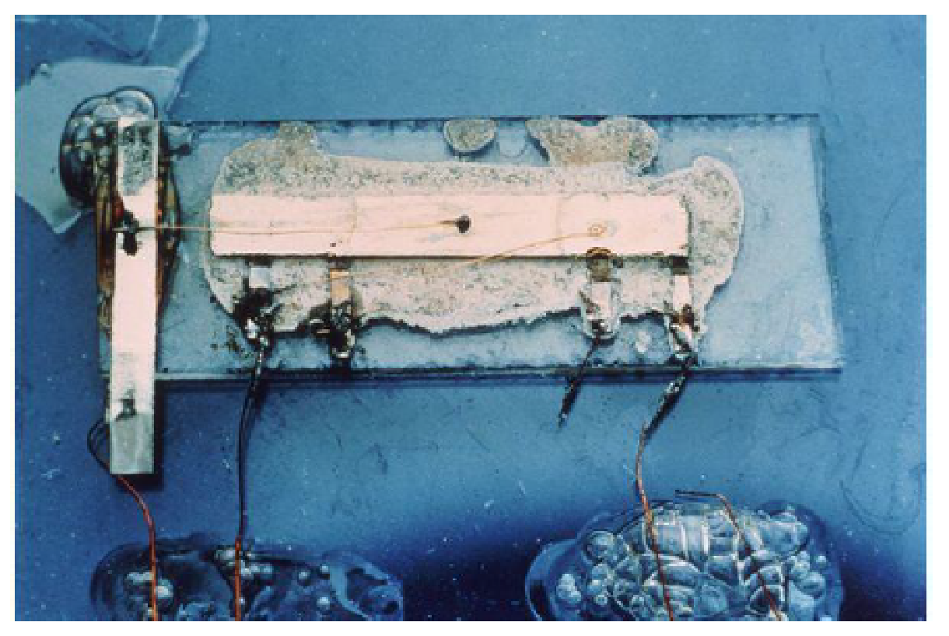
FIRST INTEGRATED CIRCUIT (IC) INVENTED IN 1959
Proposed independently by Bob Noyce at Fairchild and Jack Kilby at Texas Instruments
In 1968 Noyce and Moore left Fairchild to found Intel
First IC contained a single transistor and supporting components
The first working integrated circuit (1.6 × 11.1 mm)
Image: TI

Slide 10
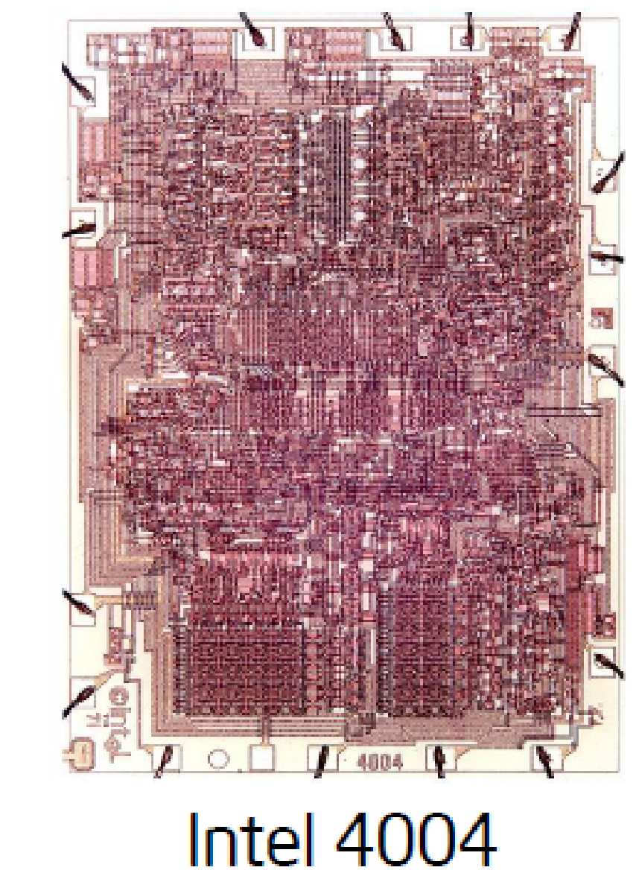
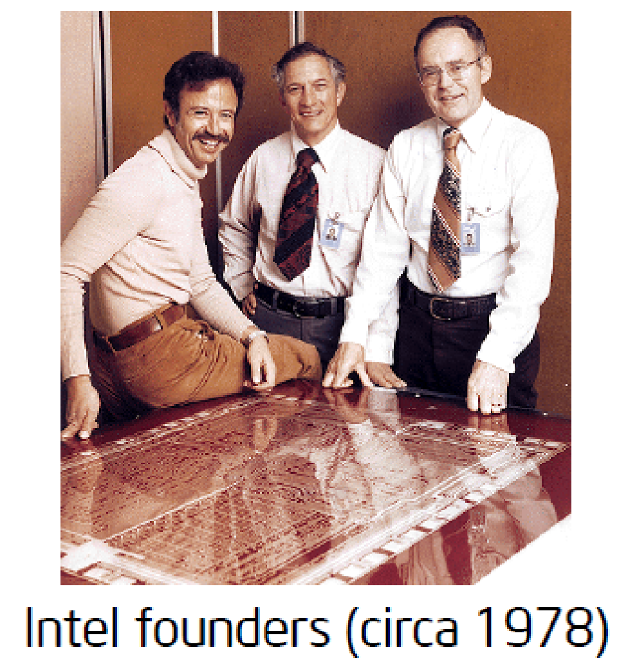
FIRST COMMERCIAL PROCESSOR BY INTEL: 4004
Intel Introduced the 4004 in 1971
4004 contained 2,300 transistors
Similar processing power as ENIAC
Image: Intel
Image: Intel

Slide 11
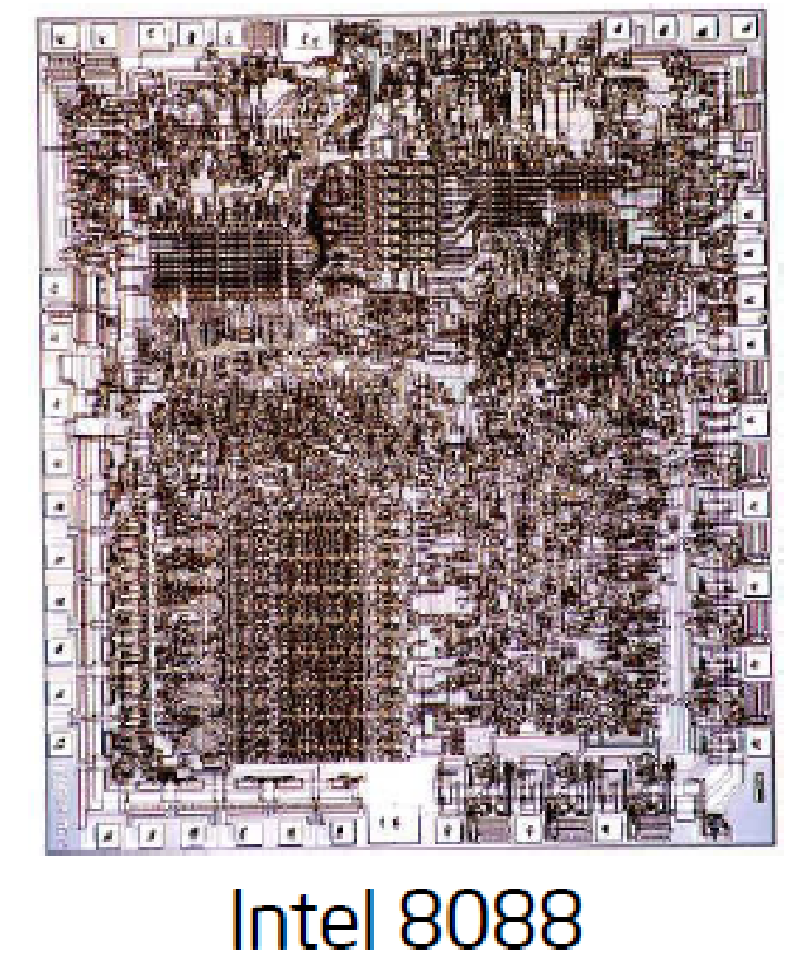
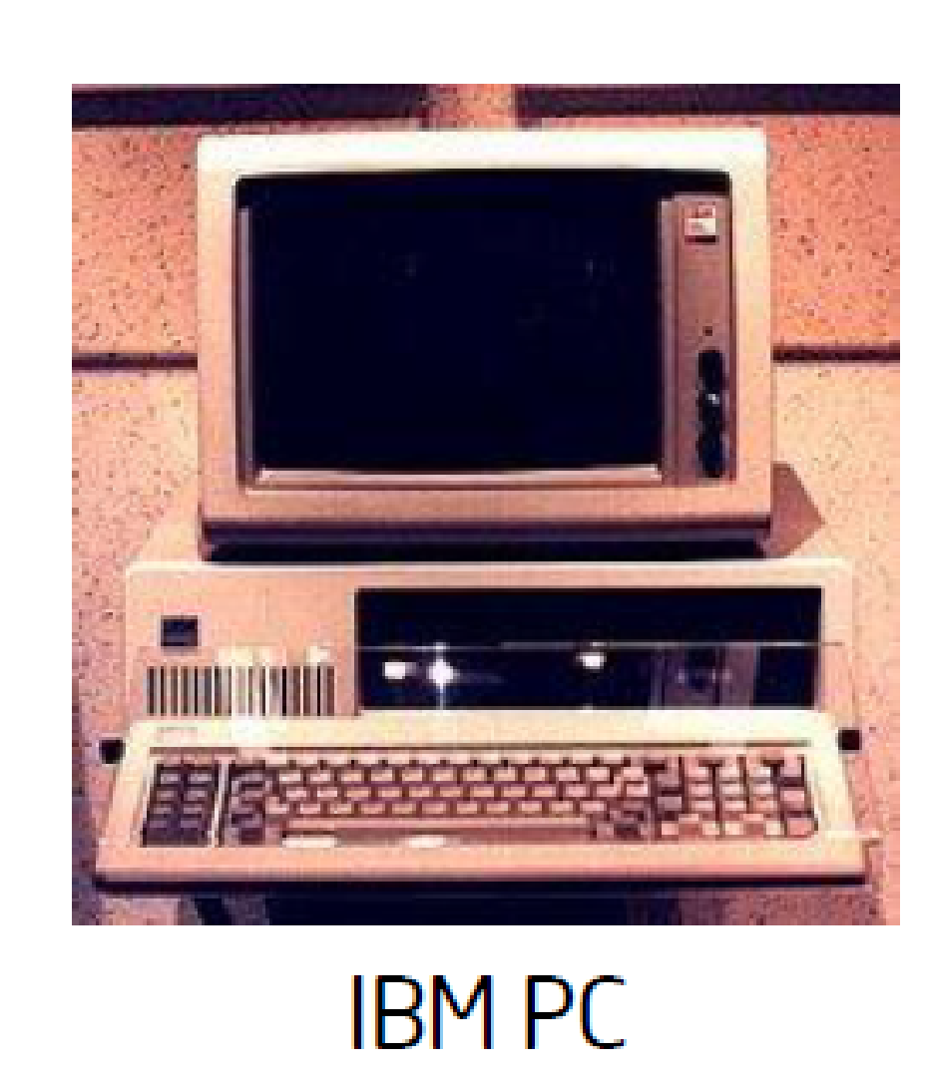
IBM INTRODUCED A PERSONAL COMPUTER IN 1981
First IBM computed used the Intel 8088 processor
8088 contained 29,000 transistors •
Used Operating System (MS-DOS) designed by Microsoft
Image: Intel
Image: Intel

Slide 12
MICROPROCESSOR EVOLUTION
Human hair- 100 µm across
4004 transistors- 10 µm across
Pentium 4 transistors- 0.13 µm across
Core2Duo- 65 nm (0.065nm) across
Latest i7- 10nm across, AMD Ryzen4 5nm
Future cores (2024)- 3nm across
Notes:
Smaller transistors allow – More transistors per chip – More processing per clock cycle – Faster clock rates – Smaller/cheaper chips
12

Slide 13
COMPUTER COMPONENTS
Microprocessor/Microcontroller — performs all computations
Cache (On Chip) — fast memory which holds current data and program
Main memory (Off Chip) — larger DRAM memory contains more data
Chipset — controls communication between components
Motherboard/Development Board — circuit board which holds all the above components
Peripherals — controls added computer accessories
Displays- 7Segments, LCD, LED
Notes:
Peripherals: Input devices (like keyboards and mice), output devices (like monitors and printers), and input/output devices (like scanners)

Slide 14
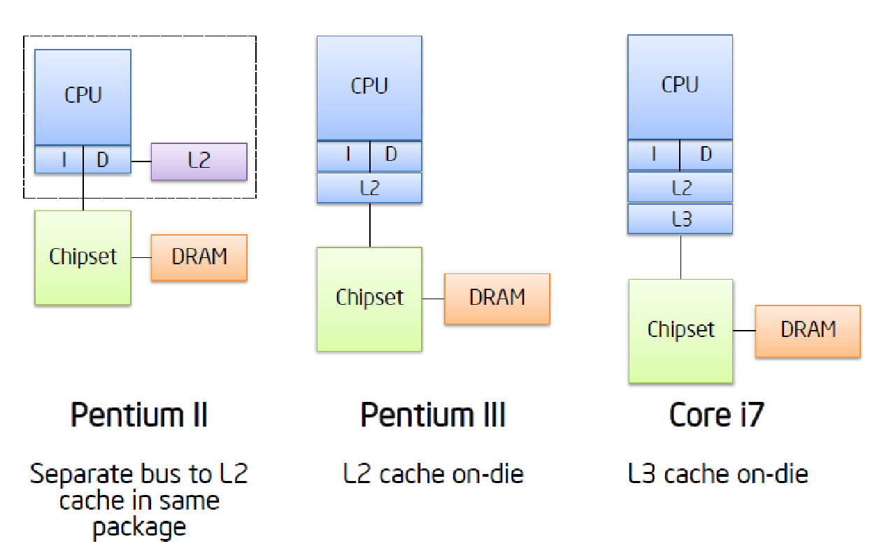
CPU AND MEMORY EVOLUTION
More no. of cores

Slide 15
Continue

